Slide 1
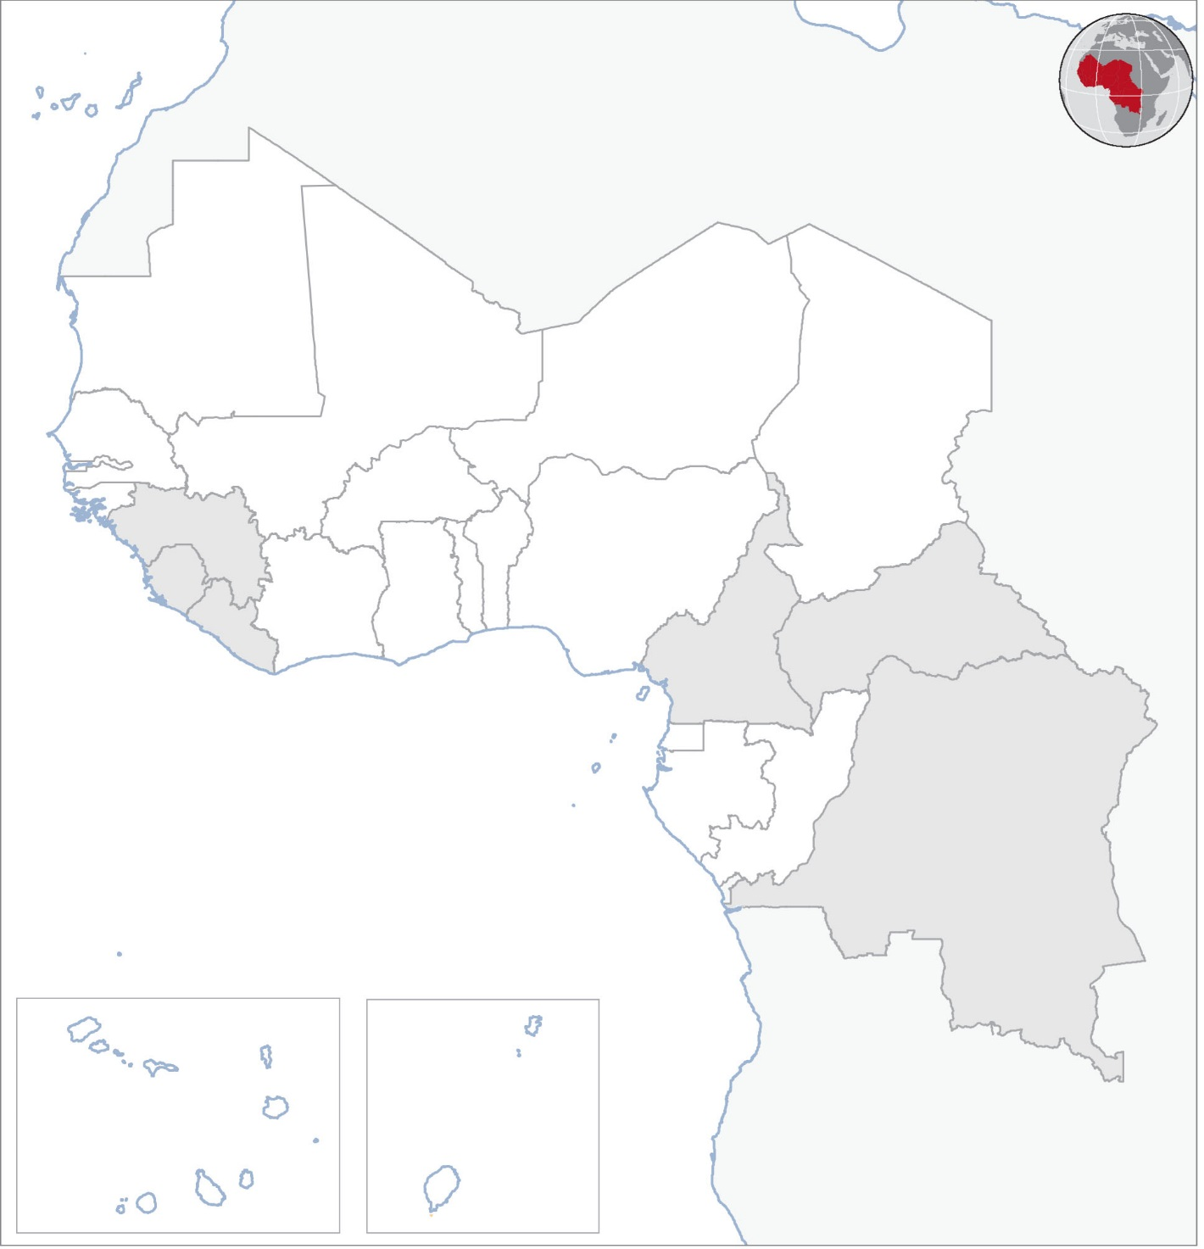
West and Central Africa: Weekly Regional Humanitarian Snapshot (8 – 14 December 2015)
CAMEROON
At least seven civilians were killed on 11 December in a suicide attack in Kolofata in Far North Region which has repeatedly come under attack by suspected Boko Haram members. A series of suicide bombings have targeted civilians and security forces in the region since July.
CENTRAL AFRICAN REPUBLIC
On 9 December, armed men in Bossangoa attacked, briefly detained and robbed more than 20 staff members of several international NGOs who were travelling on the road that links Bossangoa and Kamba Kota. In a separate incident on the same day, three humanitarian workers were attacked and robbed by armed assailants in Bangui’s PK9 neighbourhood. Since the start of the year, more than 200 attacks have been perpetrated against humanitarian organizations. UN Humanitarian Coordinator Aurélien Agbénonci condemned the attacks.
Heavy weapons fire during the 13 December referendum vote killed at least five people in Bangui’s PK5 district as people turned up to cast their ballots, prompting UN peacekeepers to move in to protect lives. The vote is seen as a test run for presidential and parliamentary elections due on 27 December.
DEMOCRATIC REPUBLIC of CONGO
As of 9 December, heavy flooding triggered by torrential rains since 19 November had killed 31 people and rendered some 20,000 others homeless in the capital Kinshasa. Many of the deaths were as a result of collapsing houses in poor neighbourhoods in the east and south of the city along River Congo. President Joseph Kabila has ordered the Kinshasa municipality and the central government to provide assistance to those affected.
EVD REGIONAL
Liberia has reported no new case since 20 November. All the 165 contacts identified following the resurgence of Ebola on 19 November successfully completed their 21-day observation period on 11 December and are no longer being monitored. As of 14 December, no new cases were reported in Guinea or Sierra Leone. In Sierra Leone, two districts - Kenema and Western Area - have been chosen as pilot districts to transfer Ebola coordination responsibilities from the national to the district level.
SUICIDE BLAST KILLS SEVEN
FLOODS KILL 31, LEAVE 20,000 HOMELESS
MAURITANIA
MALI
NIGER
AID WORKERS ATTACKED
CHAD
BURKINA FASO
GUINEA
BENIN
NIGERIA
CENTRAL AFRICAN REPUBLIC
SIERRA LEONE
COTE D’IVOIRE
GHANA
LIBERIAN EVD CONTACTS END OBSERVATION PERIOD
LIBERIA
CAMEROON
TOGO
EVD REGIONAL
GUINEA EQUATORIAL
CONGO
DEMOCRATIC REPUBLIC OF CONGO
GABON
FIVE KILLED IN POLL DAY VIOLENCE
CABO VERDE
SAO TOME E PRINCIPE
Natural disaster
Epidemic
Conflict
Other
Creation date: 14 December 2015 Map data sources: UNCS, DevInfo, OCHA. Feedback: ocharowca@un.org
The boundaries and names shown and the designations used on this map do not imply official endorsement or acceptance by the United Nations.

